Slide 1

Introduction to Python
History, Functions, and Modules
Name – ACHHUTA NAND JHA

Slide 2

Table of Contents
1. Introduction and History of Python
2. Python Functions
3. Python Modules

Slide 3
Introduction to Python
Definition of Python
Key Features:
- Easy to read and write
- Interpreted language
- High-level language
- Dynamically typed

Slide 4

History of Python
Created by Guido van Rossum
First released in 1991
Influences: ABC language, C, and Unix
Evolution of Python versions (Python 2.x, Python 3.x)
Python Software Foundation

Slide 5

Python's Popularity and Use Cases
Web development (Django, Flask)
Data Science and Machine Learning (Pandas, NumPy, scikit-learn)
Automation and Scripting
Software Development
Education

Slide 6
Introduction to Functions in Python
Definition of a Function
Benefits of Using Functions:
- Code Reusability
- Modularity
- Easy Maintenance

Slide 7
Defining Functions in Python
Syntax of Function Definition:
- def keyword
- Function name
- Parameters
- Indentation and body
- return statement
Example

Slide 8
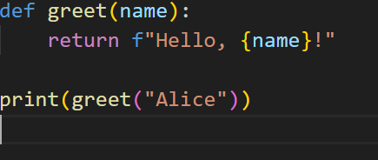
Function Example
j

Slide 9
Built-in Functions in Python
Examples: print(), len(), type(), int(), etc.
Using built-in functions in your code

Slide 10
Introduction to Modules in Python
Definition of a Module
Benefits of Using Modules:
- Code Organization
- Code Reusability
- Namespace Management

Slide 11
Creating and Using Modules
Creating a Module
Importing a Module:
- import keyword
- from ... import ... syntax
Example

Slide 12
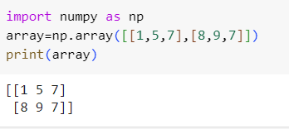
Module Example

Slide 13
Popular Python Modules
Standard Library Modules: os, sys, math, datetime, etc.
Third-party Modules: requests, NumPy, Pandas, etc.

Slide 14
Summary
Recap of Python's History
Importance of Functions
Benefits of Modules

Slide 15

Thank You
Thank you for your attention

